Slide 2
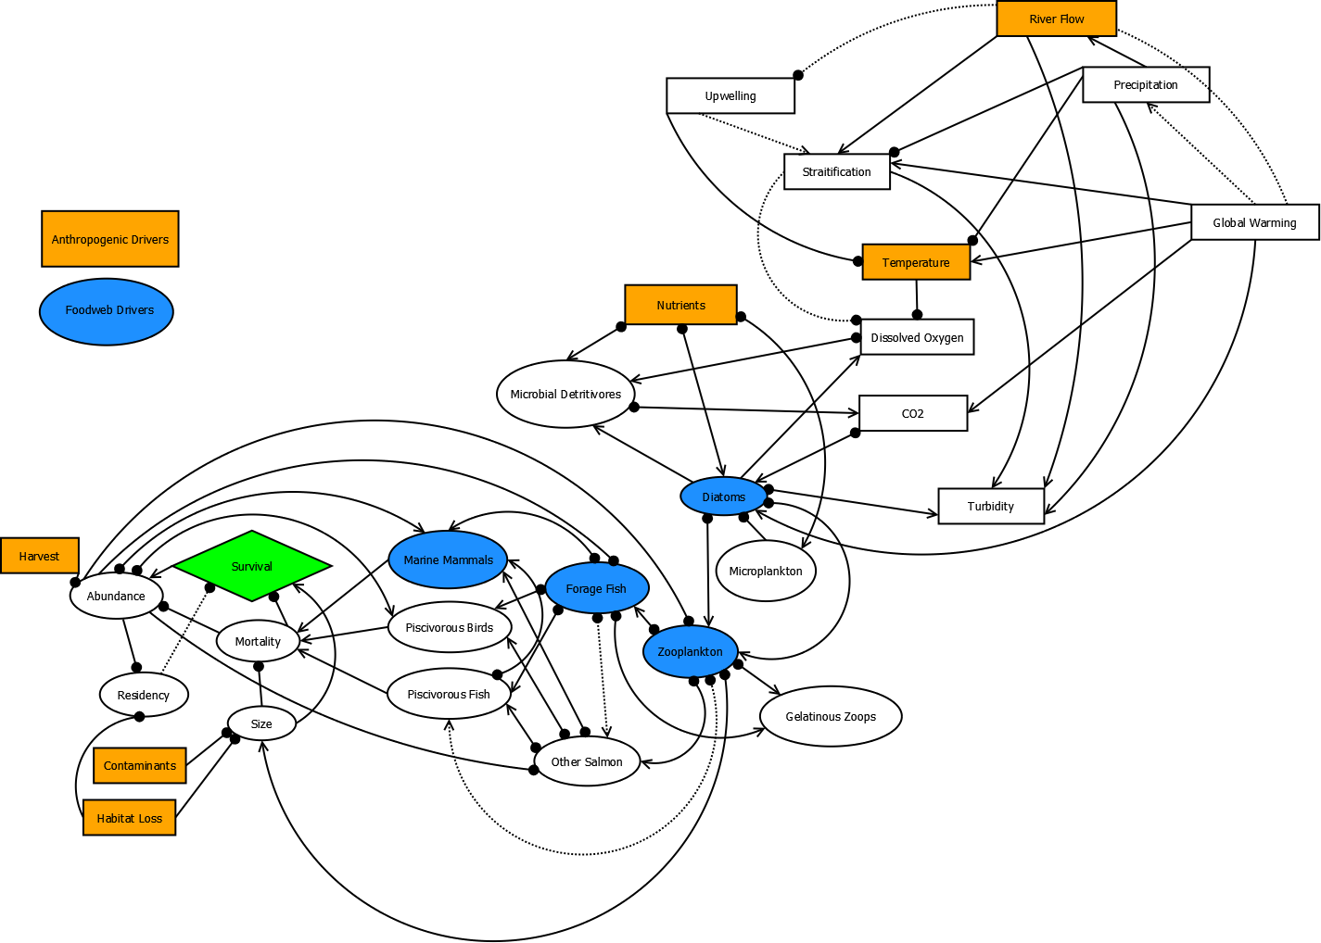

Slide 3
Methods
Generate qualitative network model using digraphing software (Dia)
Relationships are (-), (+), or unknown (0)
Uncertain relationships can be expressed with broken lines
Using QPress package in R, model impacts of press perturbations (anthropogenic and foodweb drivers and a combination, in this case)
Assign random weights to each non-zero element; assess stability; resample
Derive marginal likelihoods p(y|M) from simulation

Slide 4
